Slide 1

The in-depth analysis on HBD Pricing
Denzel See (p2222840) DAAA1B07

Slide 2
Dataset
Singapore Housing Dataset consists of:
Date
Location (Address, Town, etc)
Flat type & model
Lease start & remaining
Resale price of HDB
Price per square meter
& Price per square meter yearly
Singapore Housing Dataset have:
34 Data fields
840918 rows
Consists of data about Singapore’s HDB flats
Note: Region is a group created which takes 3 towns which are the furthest in their respective directions (e.g., North, South, East, West)

Slide 3
Objective 1
To find out what are the factors that affect the price of HBD flats

Slide 4
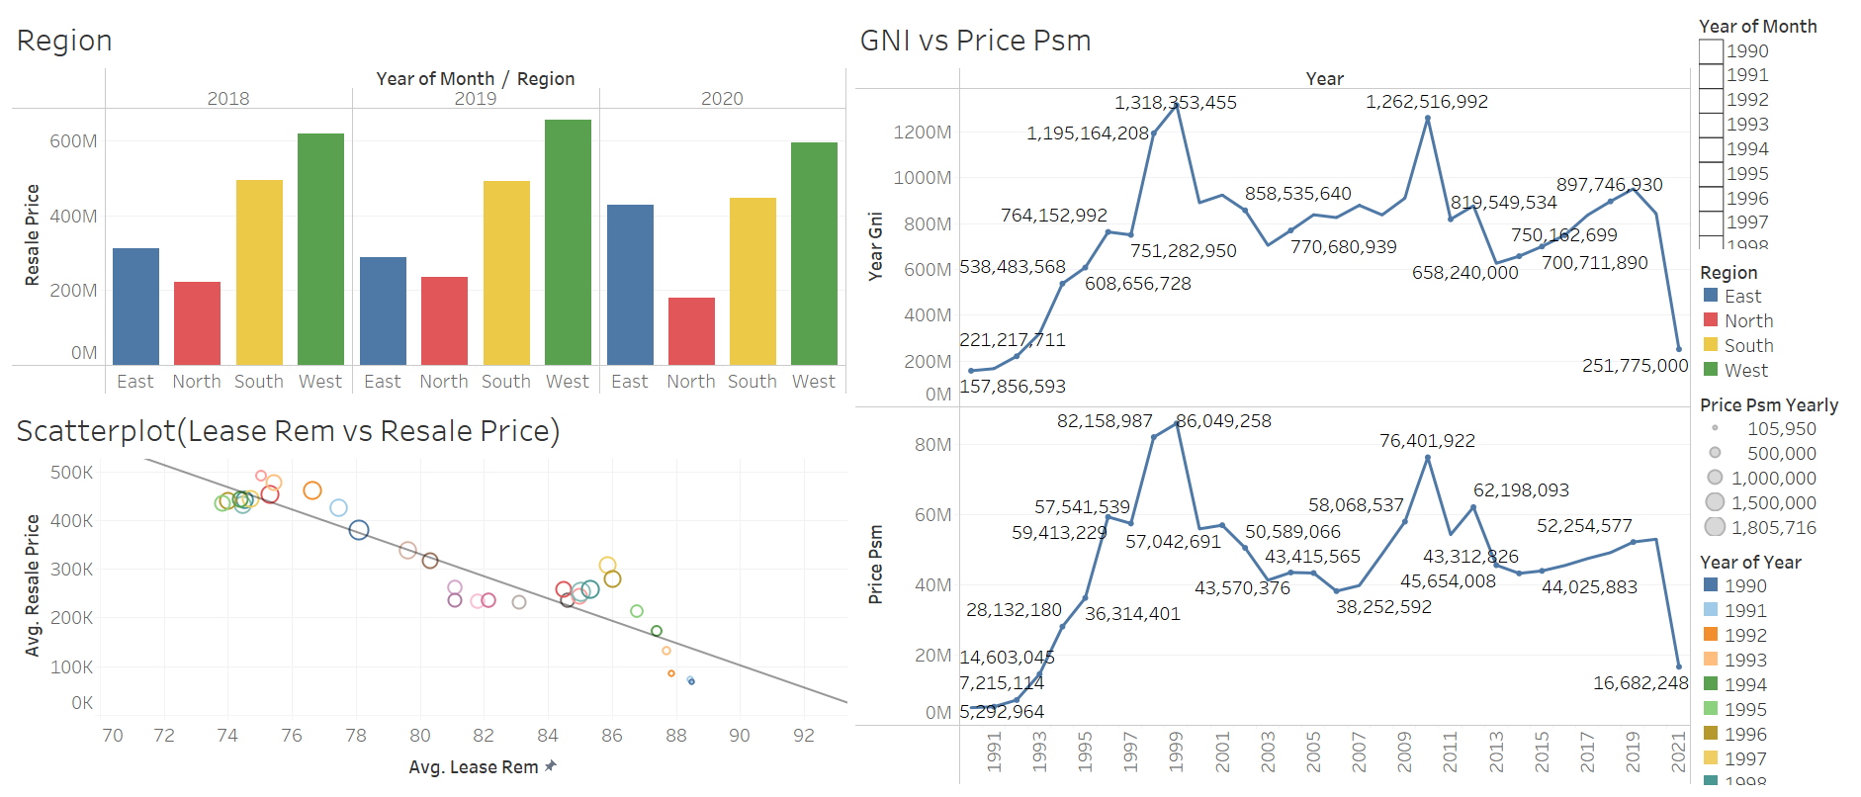
Dashboard 1

Slide 5
Insights
Region, Gross National Income and Lease remaining all affect the price of HDB flats
Gross National Income seemingly have the greatest effect on the price of HDB flats as they are almost identical in terms of shape
Region seems to be very consistent every year varying slightly in their own region but having large differences when comparing to each other
Lease remaining have a negative linear relationship against Resale price over the years

Slide 6
Objective 2
To find out how impactful each of the three factors affect the price of the HBD

Slide 7
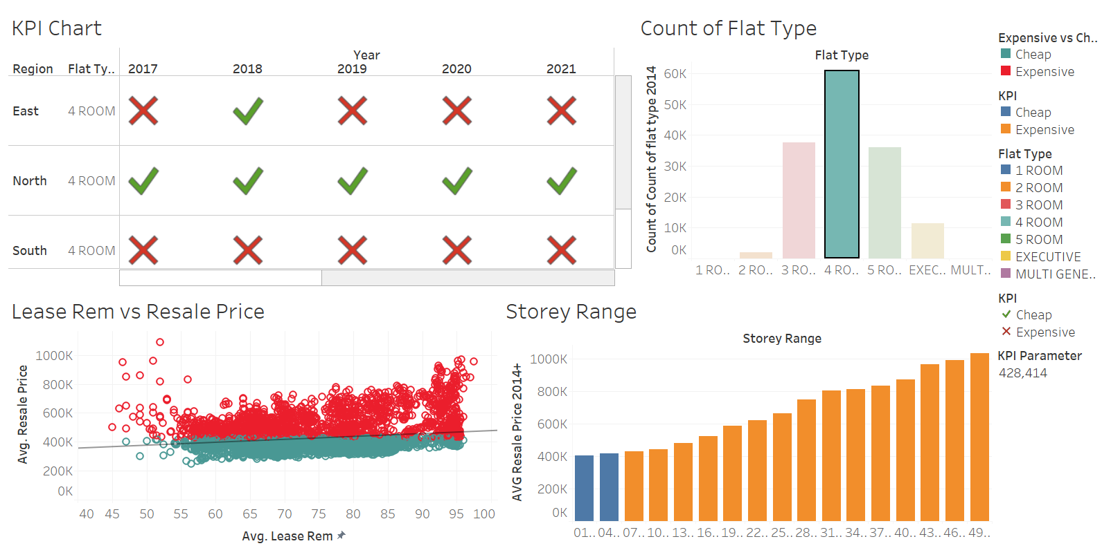
Dashboard 2

Slide 8
Insights
To note:
Data used is filtered from 2014-2021 for all graphs in Dashboard 2
Data used is further filtered to only 4 room flats as it is the flat type that has the highest frequency
Cheap vs Expensive is determined by the average price of 4 room flats from years 2014-2021
Region have a big impact on the price of housing as North and West is consistently cheap over 8 years and the South is consistently expensive over the same span of years

Slide 9
Insights
The HDB ‘s storey almost have a huge impact on the price of HDB as only floors 1-6 were in the cheap category while the price rises up to $1031877 on floors 49-51
That is a 256% increase in price from the 1st 3 floors at price $402504
The lease remaining does not as much of a large impact as other factors as its trend line almost horizontal with a r-squared value of 0.05 showing weak relationship with HDB resale prices

Slide 10
Suggestion
The price of regions should be balanced out.
The government either can:
Build facilities and attractions that are the reason why more expensive regions have their price
OR
Make travelling around Singapore much cheaper, quicker and simpler so that regions are not as much of a factor when deciding a place to stay
To note:
No references were used

